Slide 1

Functions

Slide 2
Recap
Functions
libraries
Static methods

Slide 3
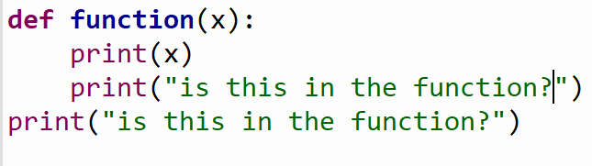
Example

Slide 4
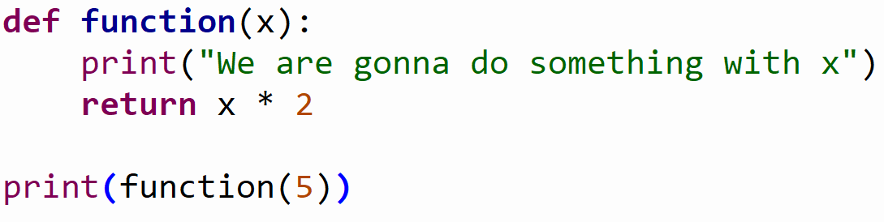
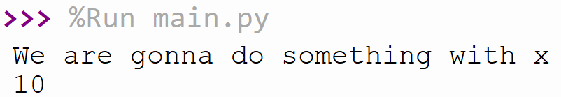
Example

Slide 5
Exercises (30 min)
Use the math library
Create a function that takes 1 parameter that will be the number given by the user.
Give power of from 1 to the number given by the user
So if the user enter the number 5 the function will print
1² = 1
2² = 4
…
--------------------------------------------------------------------------------------------------------------
Create a second function that also takes 1 parameter that will be the number given by the user
Go from 1 to the user input
At every point you add the result from the power of the number to the value.
So if the user enters 5 the returned result from the function should be
1² + 2² + 3² + 4² + 5² = …

Slide 6
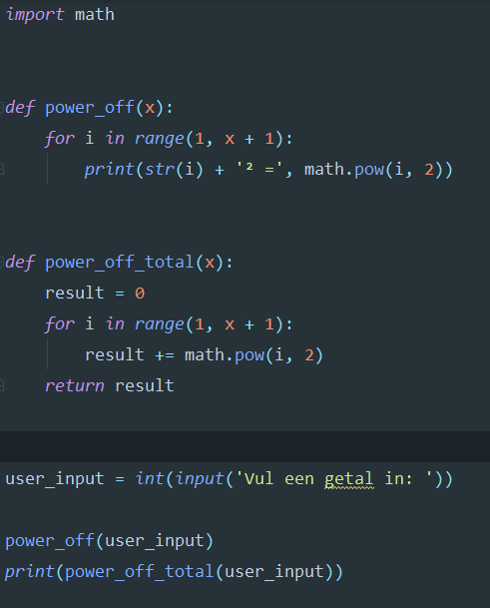
Result

Slide 7
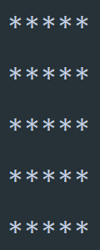
Example
How could we create a grid?

Slide 8
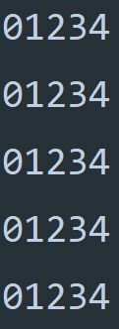
Example
What do we need to use to create this?
A user input (how big the grid should be)
A function that prints the grid
…

Slide 9
Exercise create a grid (20 min)
A user input (how big the grid should be)
A function that prints the grid
…

Slide 10
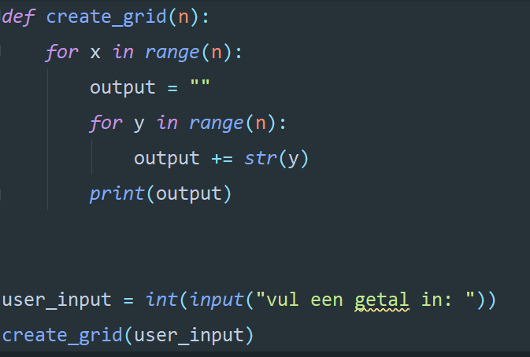
Result

Slide 11

What is unclear?

Slide 12
What would you want to see in the next lessons?

Slide 13
My experiences and expertise?

Slide 14
Summary
More about functions
How do we make a simple grid
Discussed all things that were unclear
Talked about what you want to see in these lessons

